Slide 1
Computer Networks
Basics of Networks
S.V.Jansi Rani
Assistant Professor / CSE
Notes:
The University of Adelaide, School of Computer Science
Chapter 2 — Instructions: Language of the Computer

Slide 2
Agenda
Data Communication
Networks
Type of connections
Topology –Mesh, Star, Ring, Bus
Types of networks –LAN, WAN, Internet
Protocol
Notes:
The University of Adelaide, School of Computer Science
Chapter 2 — Instructions: Language of the Computer

Slide 3
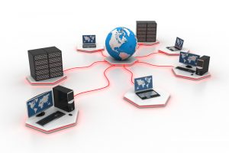


Slide 4
1-1 DATA COMMUNICATIONS
The term telecommunication means communication at a distance. The word data refers to information presented in whatever form is agreed upon by the parties creating and using the data. Data communications are the exchange of data between two devices via some form of transmission medium such as a wire cable.
Topics discussed in this section:
Components
Data Représentation
Data Flow
Notes:
1.#

Slide 5

Five components of data communication
Notes:
1.#

Slide 6
Data Communication
Effectiveness of DC
Delivery
Accuracy
Timeliness
Jitter
Notes:
The University of Adelaide, School of Computer Science
Chapter 2 — Instructions: Language of the Computer

Slide 7
Data Representation
Effectiveness of DC
Text
Numbers
Images
Audio
Video
Notes:
The University of Adelaide, School of Computer Science
Chapter 2 — Instructions: Language of the Computer

Slide 8

DATA FLOW
Car, Walkie Talkie
Telephone
Notes:
1.#

Slide 9
1-2 NETWORKS
A network is a set of devices (often referred to as nodes) connected by communication links. A node can be a computer, printer, or any other device capable of sending and/or receiving data generated by other nodes on the network.
Topics discussed in this section:
Network Criteria
Physical Structures
Network Models
Categories of Networks
Interconnection of Networks: Internetwork
Notes:
1.#

Slide 10
Network Criteria
Performance
  Transit time
  Response time
  Throughput
  Delay
Reliability
  Frequency of failure
Security
  Protection from unauthorized access, damage
  Policy to recover from breach and data loss

Slide 11

Types of connections
Notes:
1.#

Slide 12

Topology
Geometric representation of the relationship of all link and nodes to one another.
Notes:
1.#

Slide 13

Mesh
n(n-1) links
Duplex links: n(n-1)/2
Advantage:
Dedicated link
Less traffic
Robust
Privacy
Fault identification easy
Disadvantage:
Amount of cabling
Hardware is expensive
Example:
Backbone
Telephone regional office connection at backbone.
Notes:
1.#

Slide 14

STAR
Advantage:
Easy installation and configuration
Less cabling
Robust
Disadvantage:
Single point failure
Example:
LAN
Notes:
1.#

Slide 15

BUS
Advantage:
Backbone cables- less cabling
Disadvantage:
Fault isolation
Difficult reconnection
Adding new device difficult
Faults stops transmission of others
Example:
Ethernet LAN
Notes:
1.#

Slide 16

RING
Advantage:
Easy installation and configuration
Fault isolation easy
Disadvantage:
Unidirectional traffic
Single break – dual ring solution
Example:
IBM introduced its LAN
Less popular because of high speed LAN
Notes:
1.#

Slide 17

Figure 1.9 A hybrid topology: a star backbone with three bus networks
Notes:
1.#

Slide 18
Network Types
Local Area Network (LAN)
Wide Area Network (WAN)
Internet
Notes:
The University of Adelaide, School of Computer Science
Chapter 2 — Instructions: Language of the Computer

Slide 19
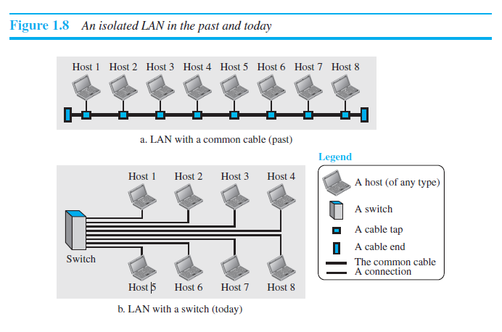
Notes:
1.#

Slide 20

Figure 1.11 WANs: a switched WAN and a point-to-point WAN
Notes:
1.#

Slide 21

Figure 1.12 A heterogeneous network made of four WANs and two LANs
Notes:
1.#

Slide 22
1-3 THE INTERNET
The Internet ha interconnects more than two networks LANs/WANs.
Topics discussed in this section:
A Brief History
The Internet Today (ISPs)
Notes:
1.#

Slide 23

Figure 1.13 Hierarchical organization of the Internet
Notes:
1.#

Slide 24
PROTOCOLS
A protocol is synonymous with rule. It consists of a set of rules that govern data communications. It determines what is communicated, how it is communicated and when it is communicated. The key elements of a protocol are syntax, semantics and timing
Topics discussed in this section:
Syntax
Semantics
Timing
Notes:
1.#

Slide 25
Elements of a Protocol
Syntax
  Structure or format of the data
  Indicates how to read the bits - field delineation
Semantics
  Interprets the meaning of the bits
  Knows which fields define what action
Timing
  When data should be sent and what
  Speed at which data should be sent or speed at which it is being received.
Notes:
1.#

Slide 26
Summary
Students are exposed with the
Data Communication
Networks
Type of connections
Topology –Mesh, Star, Ring, Bus
Types of networks –LAN, WAN, Internet
Protocol
Notes:
The University of Adelaide, School of Computer Science
Chapter 2 — Instructions: Language of the Computer

Slide 27
Test Your Understanding
Which topology demands less cabling ?
  Star
  Ring
  Bus
Effectiveness of data communication depends on
  Delivery
  Security
  Scalability

Slide 28
THANK YOU

